Slide 1
Week-8 Session-1
Marketing: Helping Buyers Buy

Slide 2



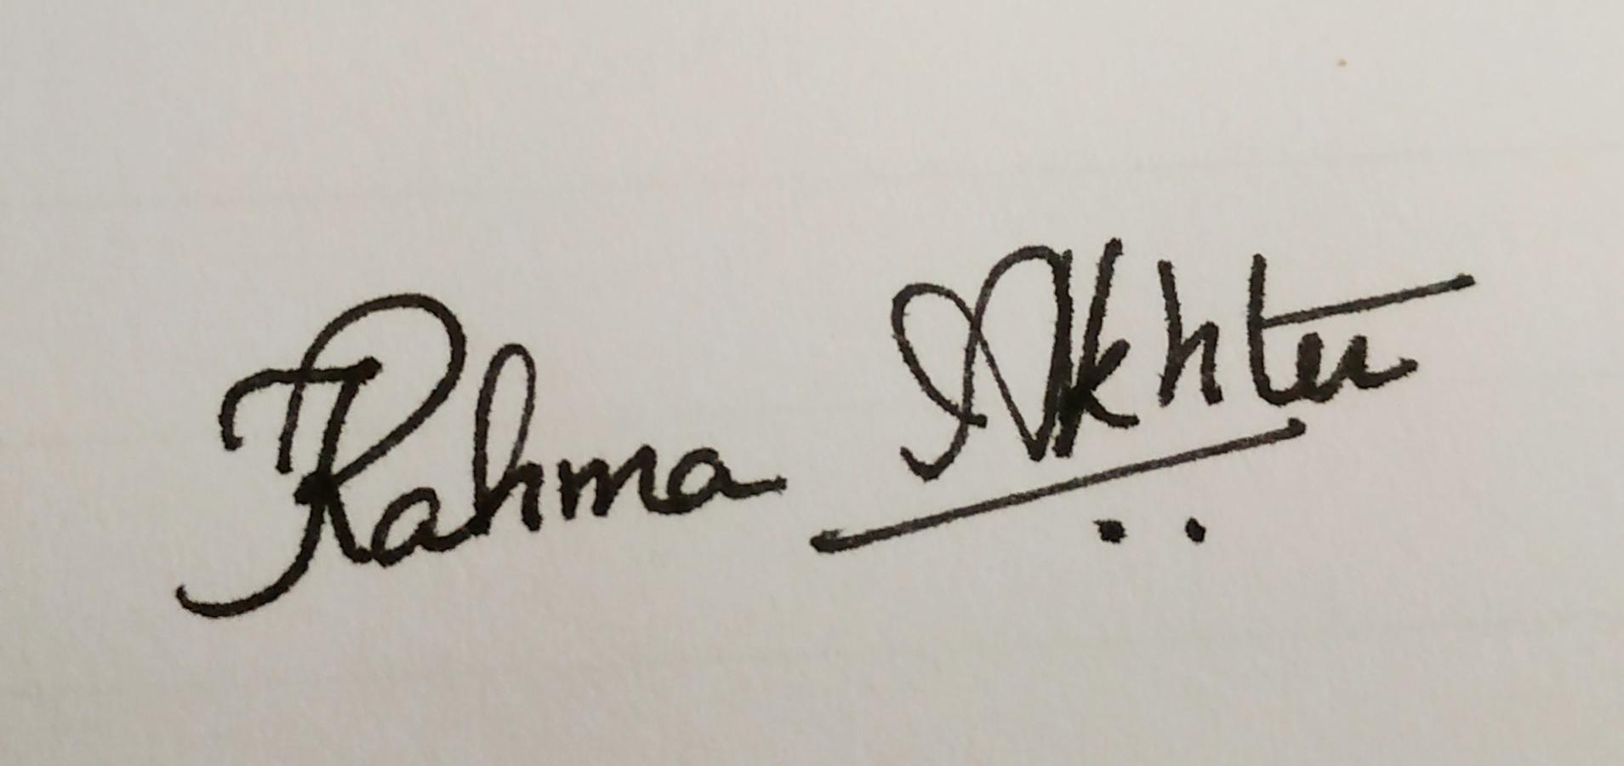
Two different Markets
*
Chapter Thirteen
*
A market consists of people with unsatisfied wants & needs who have the resources and the willingness to buy. 2 major markets in business are:
Consumer Market -- All the individuals or households that want goods and services for personal use and have the resources to buy them.
Business-to-Business (B2B) -- Individuals and organizations that buy goods and services to use in production or to sell, rent or supply to others.
McGraw-Hill/Irwin
Copyright © 2010 by The McGraw-Hill Companies, Inc. All rights reserved.

Slide 3
MARKETING to CONSUMERS
*
The Consumer Market
*
LG5
The size and diversity of the consumer market forces marketers to decide which groups they want to serve.
Market Segmentation -- Divides the total market into groups with similar characteristics.
Target Marketing -- Selecting which segments an organization can serve profitably.
13-
Notes:
See Learning Goal 5: Explain how marketers apply the tools of market segmentation, relationship marketing, and the study of consumer behavior.

Slide 4
Types of Segmentation
-Geographic
-Demographic
-Psychographic
-Behavioral

Slide 5
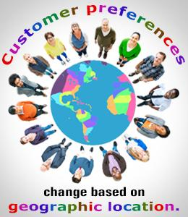
Market Segmentation
Segmenting Consumer Markets
Geographic segmentation divides the market into different geographical units such as nations, regions, states, counties, or cities

Slide 6
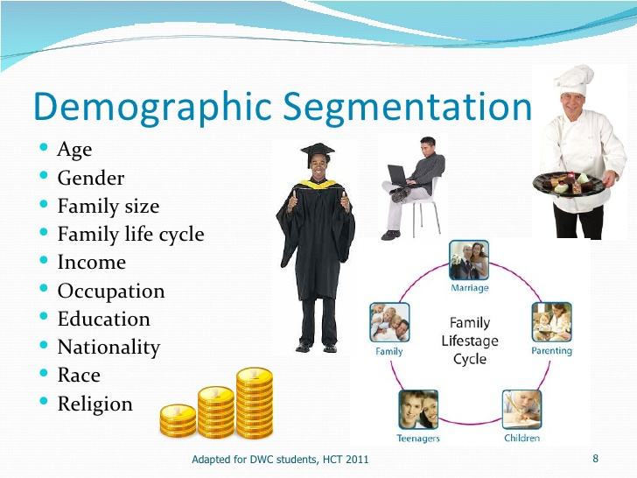
Market Segmentation
Segmenting Consumer Markets

Slide 7
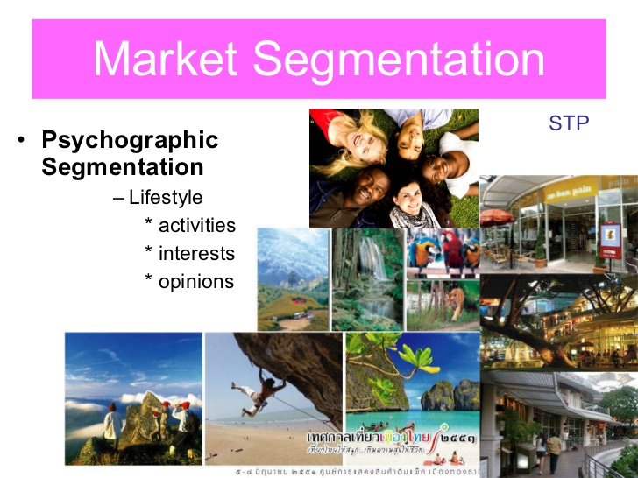
Market Segmentation
Segmenting Consumer Markets
Psychographic segmentation divides buyers into different groups based on social class, lifestyle, or personality traits
Notes:
Note to Instructor
There are a whole group of products which are targeted to the affluent including hotels like Four Seasons, which is mentioned in the book. Their products offerings are deluxe:
Kids in the City package for $520 a night and, among other things, enjoy a visit in their room from the Ice Cream Man, who arrives with all the fixings to make any concoction they desire.
The Benjamin Hotel in New York City provides dog beds in a variety of styles and doggie bathrobes, as well as canine room service and DVDs for dogs.
At the Ritz-Carlton, Lake Las Vegas in Henderson, Nevada, the Love at Lake Las Vegas weekend package includes two nights in the 2,400 square foot presidential suite, helicopter and gondola rides, a champagne-tasting party on a yacht complete with rose petals strewn about and a string trio, use of a luxury car throughout the stay, in-room couples spa treatment, a $5,000 casino line of credit, a $50,000 shopping spree at Neiman Marcus, 14 dozen roses, and a butler-drawn Cristal champagne bath.

Slide 8
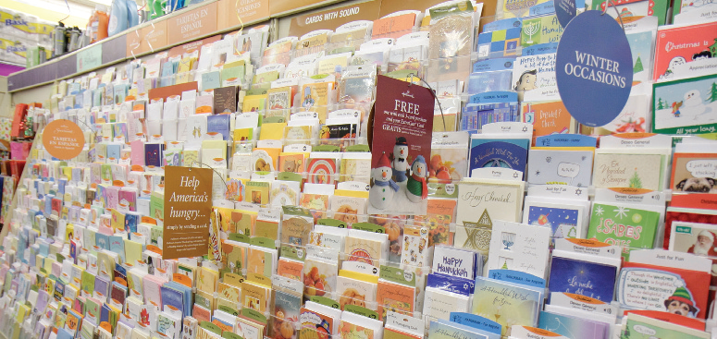
Behavioral Segmentation (1 of 2)
Marketers divide buyers into groups on the basis of their knowledge of, attitude toward, use of, or response to a product
Notes:
Although psychographic segmentation can provide a richer understanding of consumers, some marketers fault it for being somewhat removed from actual consumer behavior.

Slide 9

Behavioral Segmentation (2 of 2)
Needs and benefits
Decision roles
Initiator
Influencer
Decider
Buyer
User
Notes:
Needs-based or benefit-based segmentation identifies distinct market segments with clear marketing implications.
People play five roles in a buying decision: Initiator, Influencer, Decider, Buyer, and User. For example, assume a wife initiates a purchase by requesting a new treadmill for her birthday. The husband may then seek information from many sources, including his best friend who has a treadmill and is a key influencer in what models to consider. After presenting the alternative choices to his wife, he purchases her preferred model, which ends up being used by the entire family. Different people are playing different roles, but all are crucial in the decision process and ultimate consumer satisfaction.

Slide 10
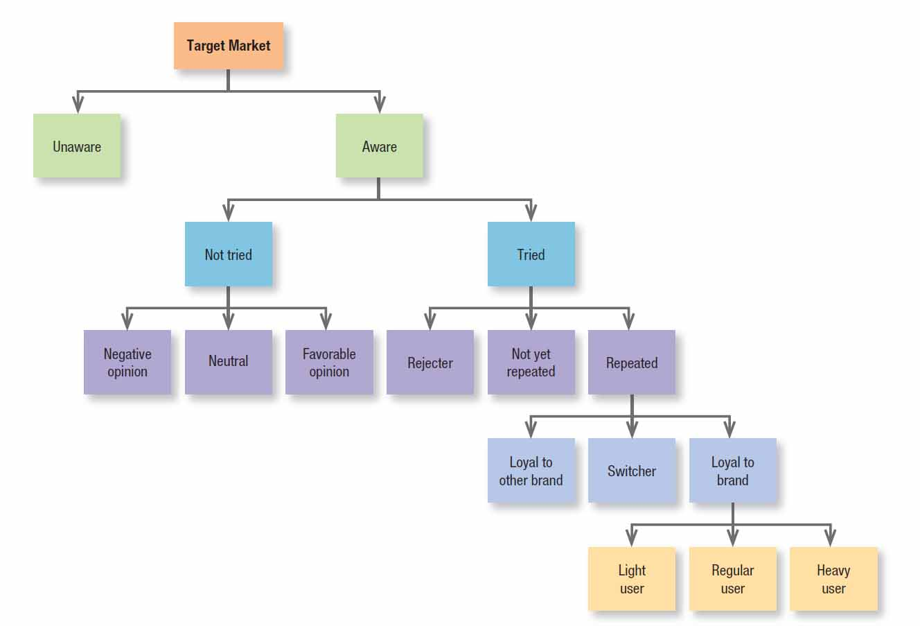
Figure: Behavioral Segmentation Breakdown
Notes:
Combining different behavioral bases can provide a more comprehensive and cohesive view of a market and its segments. Figure 9.3 depicts one possible way to break down a target market by various behavioral segmentation bases.

Slide 11
Types of target marketing
Mass
Differentiated
Niche/Concentrated
Micromarketing-Micromarketing is an approach to advertising that tends to target a specific group of people in a niche market. With micromarketing, products or services are marketed directly to a targeted group of customers.

Slide 12
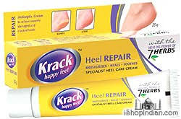

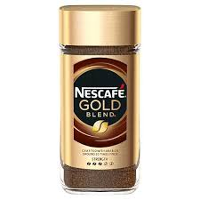
MARKETING to SMALL SEGMENTS
*
Reaching Smaller Market Segments
*
LG5
Niche Marketing -- Identifies small but profitable market segments and designs or finds products for them.
13-
Notes:
See Learning Goal 5: Explain how marketers apply the tools of market segmentation, relationship marketing, and the study of consumer behavior.

Slide 13
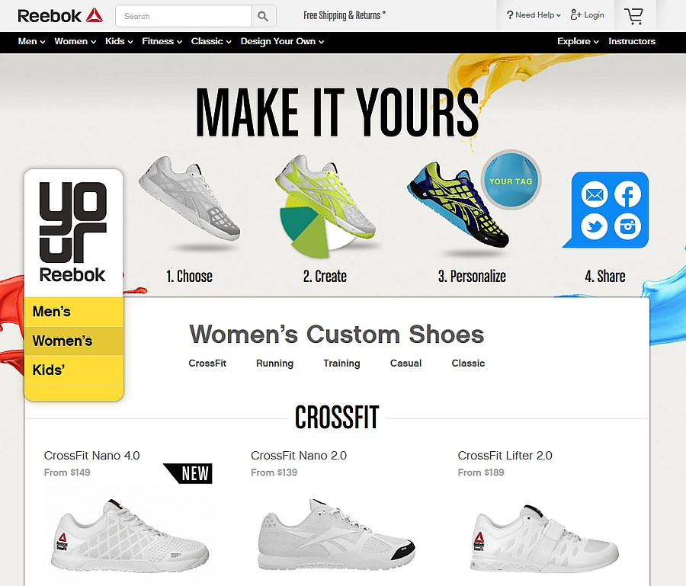
MARKETING to SMALL SEGMENTS
*
Reaching Smaller Market Segments
*
LG5
One-to-One Marketing-- Developing a unique mix of goods and services for each individual consumer.
13-
Notes:
See Learning Goal 5: Explain how marketers apply the tools of market segmentation, relationship marketing, and the study of consumer behavior.

Slide 14
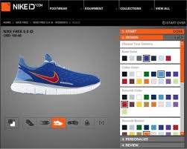
MARKETING to SMALL SEGMENTS
*
Reaching Smaller Market Segments
*
LG5
One-to-One Marketing-
13-
Notes:
See Learning Goal 5: Explain how marketers apply the tools of market segmentation, relationship marketing, and the study of consumer behavior.

Slide 15
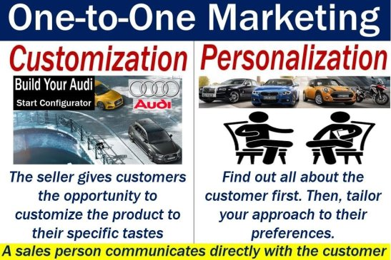
MARKETING to SMALL SEGMENTS
*
Reaching Smaller Market Segments
*
LG5
One-to-One Marketing--
Source: https://marketbusinessnews.com/financial-glossary/one-to-one-marketing-definition-meaning/
13-
Notes:
See Learning Goal 5: Explain how marketers apply the tools of market segmentation, relationship marketing, and the study of consumer behavior.

Slide 16
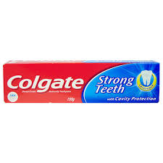
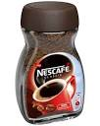
MASS MARKETING
*
Moving Toward Relationship Marketing
*
LG5
Mass Marketing -- Developing products and promotions to please large groups of people.
13-
Notes:
See Learning Goal 5: Explain how marketers apply the tools of market segmentation, relationship marketing, and the study of consumer behavior.
Mass marketing uses little market segmentation. The goal of relationship marketing is to keep customers happy by offering products that meet exact expectations

Slide 17

STEPS in the CONSUMER DECISION-MAKING PROCESS
*
The Consumer Decision-Making Process
*
LG5
Problem recognition
Search for information
Evaluating alternatives
Purchase decision
Postpurchase evaluation
13-
Notes:
See Learning Goal 5: Explain how marketers apply the tools of market segmentation, relationship marketing, and the study of consumer behavior.

Slide 18

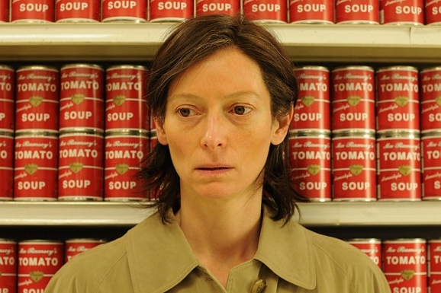
Need Recognition
The buying process starts with need recognition ─ the buyer recognizes a problem or need.
The need can be triggered by internal stimuli when one of the person’s normal needs ─ for example, hunger or thirst ─ rises to a level high enough to become a drive.
A need can also be triggered by external stimuli.

Slide 19


Information Search
Information search is the stage of the buyer decision process in which the consumer is motivated to search for more information.
Traditionally, consumers have received the most information about a product from commercial sources that controlled by the marketer.
The most effective sources tend to be personal.
Commercial sources normally inform the buyer, but personal sources legitimize or evaluate products for the buyer.

Slide 20


Evaluation of Alternatives
The alternative evaluation is the stage of the buyer decision process in which the consumer uses information to evaluate alternative brands in the choice set.
Marketers should study buyers to find out how they actually evaluate brand alternatives.

Slide 21
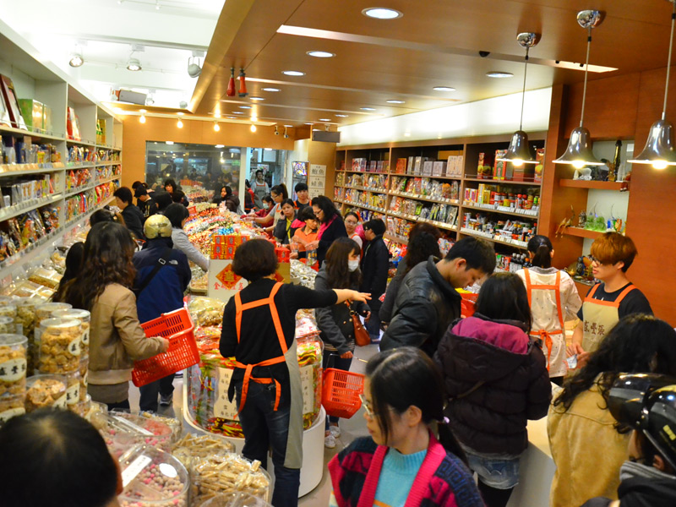
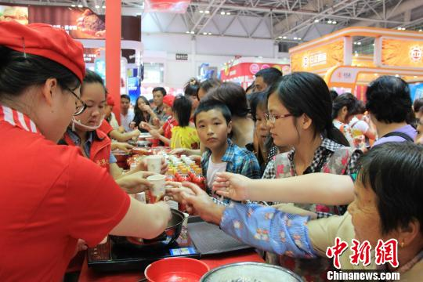
Purchase Decision
The purchase decision is the buyer’s decision about which brand to purchase.
But two factors can come between the purchase intention and the purchase decision.
The first factor is the attitudes of others.
The second factor is unexpected situational factors.

Slide 22
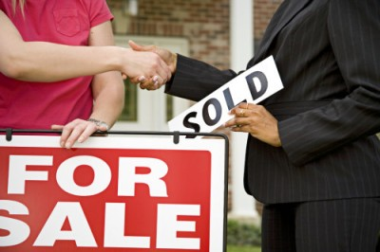
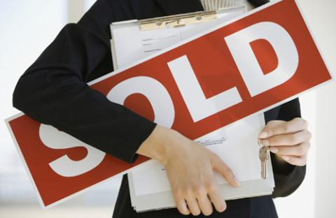
Postpurchase Behavior
The postpurchase behavior is the stage of the buyer decision process in which consumers take further action after purchase, based on their satisfaction or dissatisfaction.
Almost all major purchases, however, result in cognitive dissonance, or discomfort caused by postpurchase conflict.

Slide 23
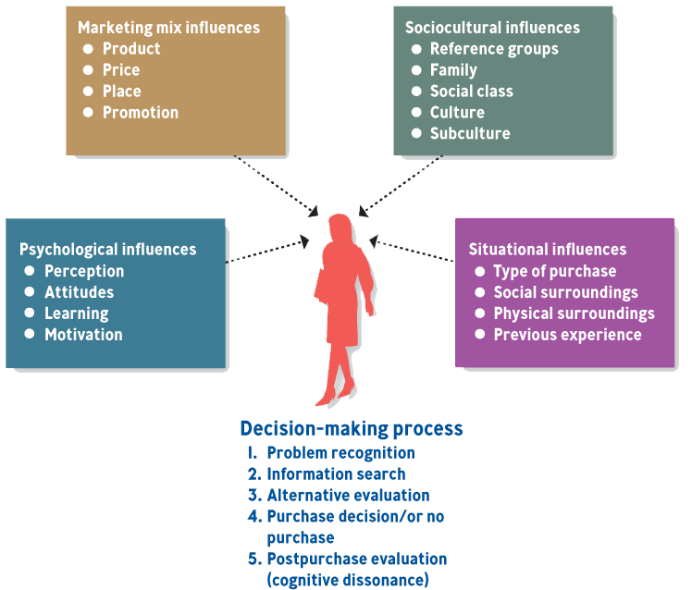
CONSUMER DECISION MAKING PROCESS AND OUTSIDE INFLUENCES
*
The Consumer Decision-Making Process
*
LG5
13-
Notes:
See Learning Goal 5: Explain how marketers apply the tools of market segmentation, relationship marketing, and the study of consumer behavior.

Slide 24

KEY FACTORS in CONSUMER DECISION-MAKING
*
The Business-to-Business Market
*
LG6
Learning
Reference Groups
Culture
Subcultures
13-
Notes:
See Learning Goal 6: Compare the business-to-business market and the consumer market.
Learning - Creates changes in consumer behavior through experiences and information.
Reference groups - Reference points in forming beliefs, attitudes, values or behaviors.
Culture - The set of values, attitudes and ways of doing things passed from generations.
Subculture - Values, attitudes and ways of doing things from belonging to a certain group.
Cognitive dissonance - Psychological conflict that may occur after a purchase.

